Slide 1
Cryptocurrency Sentiment Analysis
Crystal Han

Slide 2
Introduction
Cryptocurrency Market is very volatile
Use sentiment towards cryptocurrency
Client: Those interested in the Cryptocurrency market
Agenda:
Analyze Cryptocurrency sentiment
identify its relation with price
compare negative and positive values

Slide 3
Methodology
Data
Cryptocurrency API: Augmento, SentiCrypt
Already collected data from Augmento
Tools:
Python, Pandas, Numpy
Matplotlib, Seaborn, Scikit-Learn
Github, Flask, Heroku

Slide 4
Data Pipeline
Data Ingestion
Testing/Robustness
Obtain data from Augmento and Senticrypt as CSV files
User input will show new plots
Data Storage
Processing
Deployment
User input s to plot and calculate prediction for particular coins
Flask and Heroku
Read CSV as a dataframe, clean, and save as a json file

Slide 5
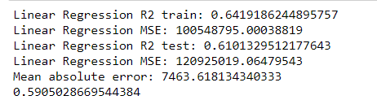
Cryptocurrency Prediction based on Sentiment Values

Slide 6
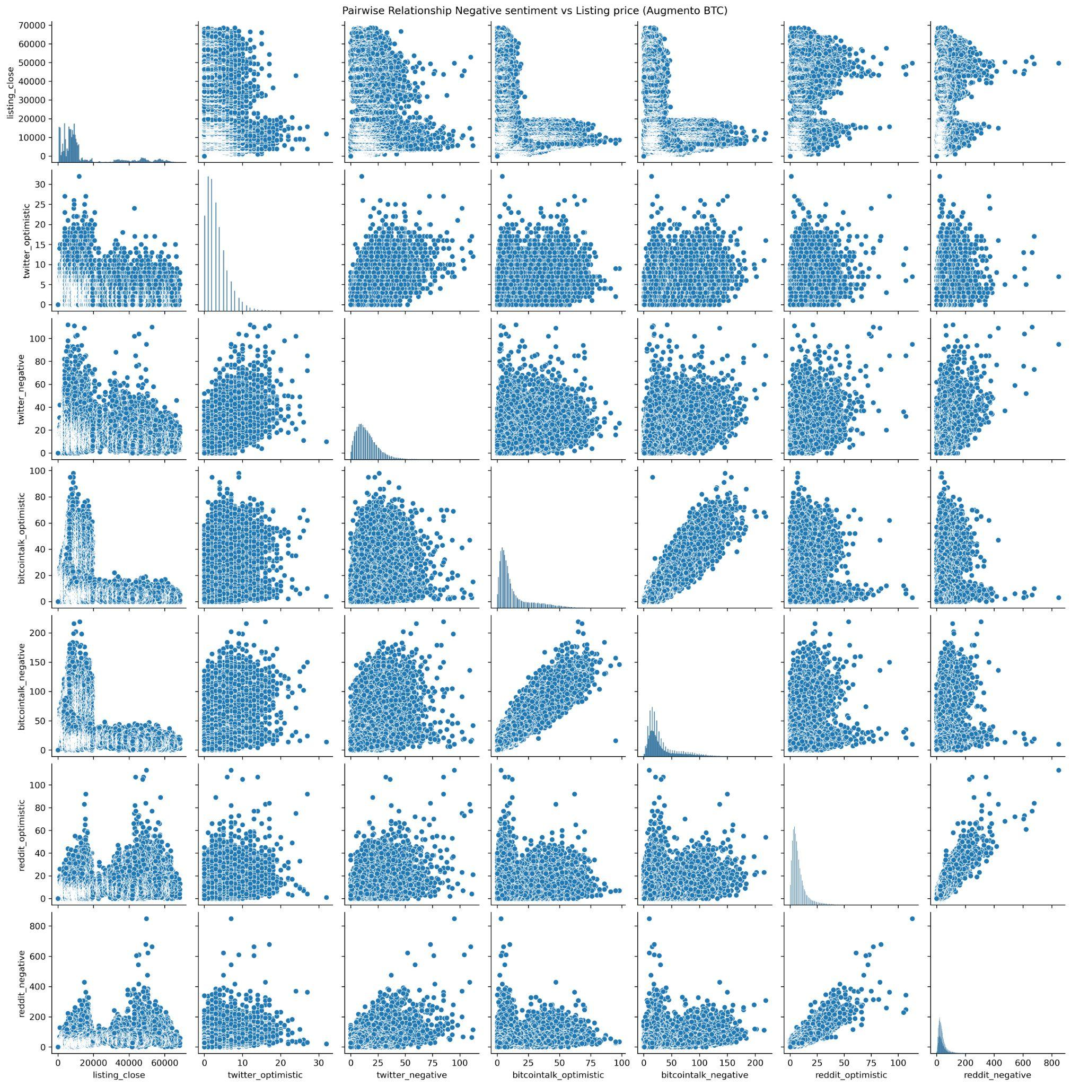
Correlation between Sentiment Values and Cryptocurrency Value (Augmento BTC)

Slide 7
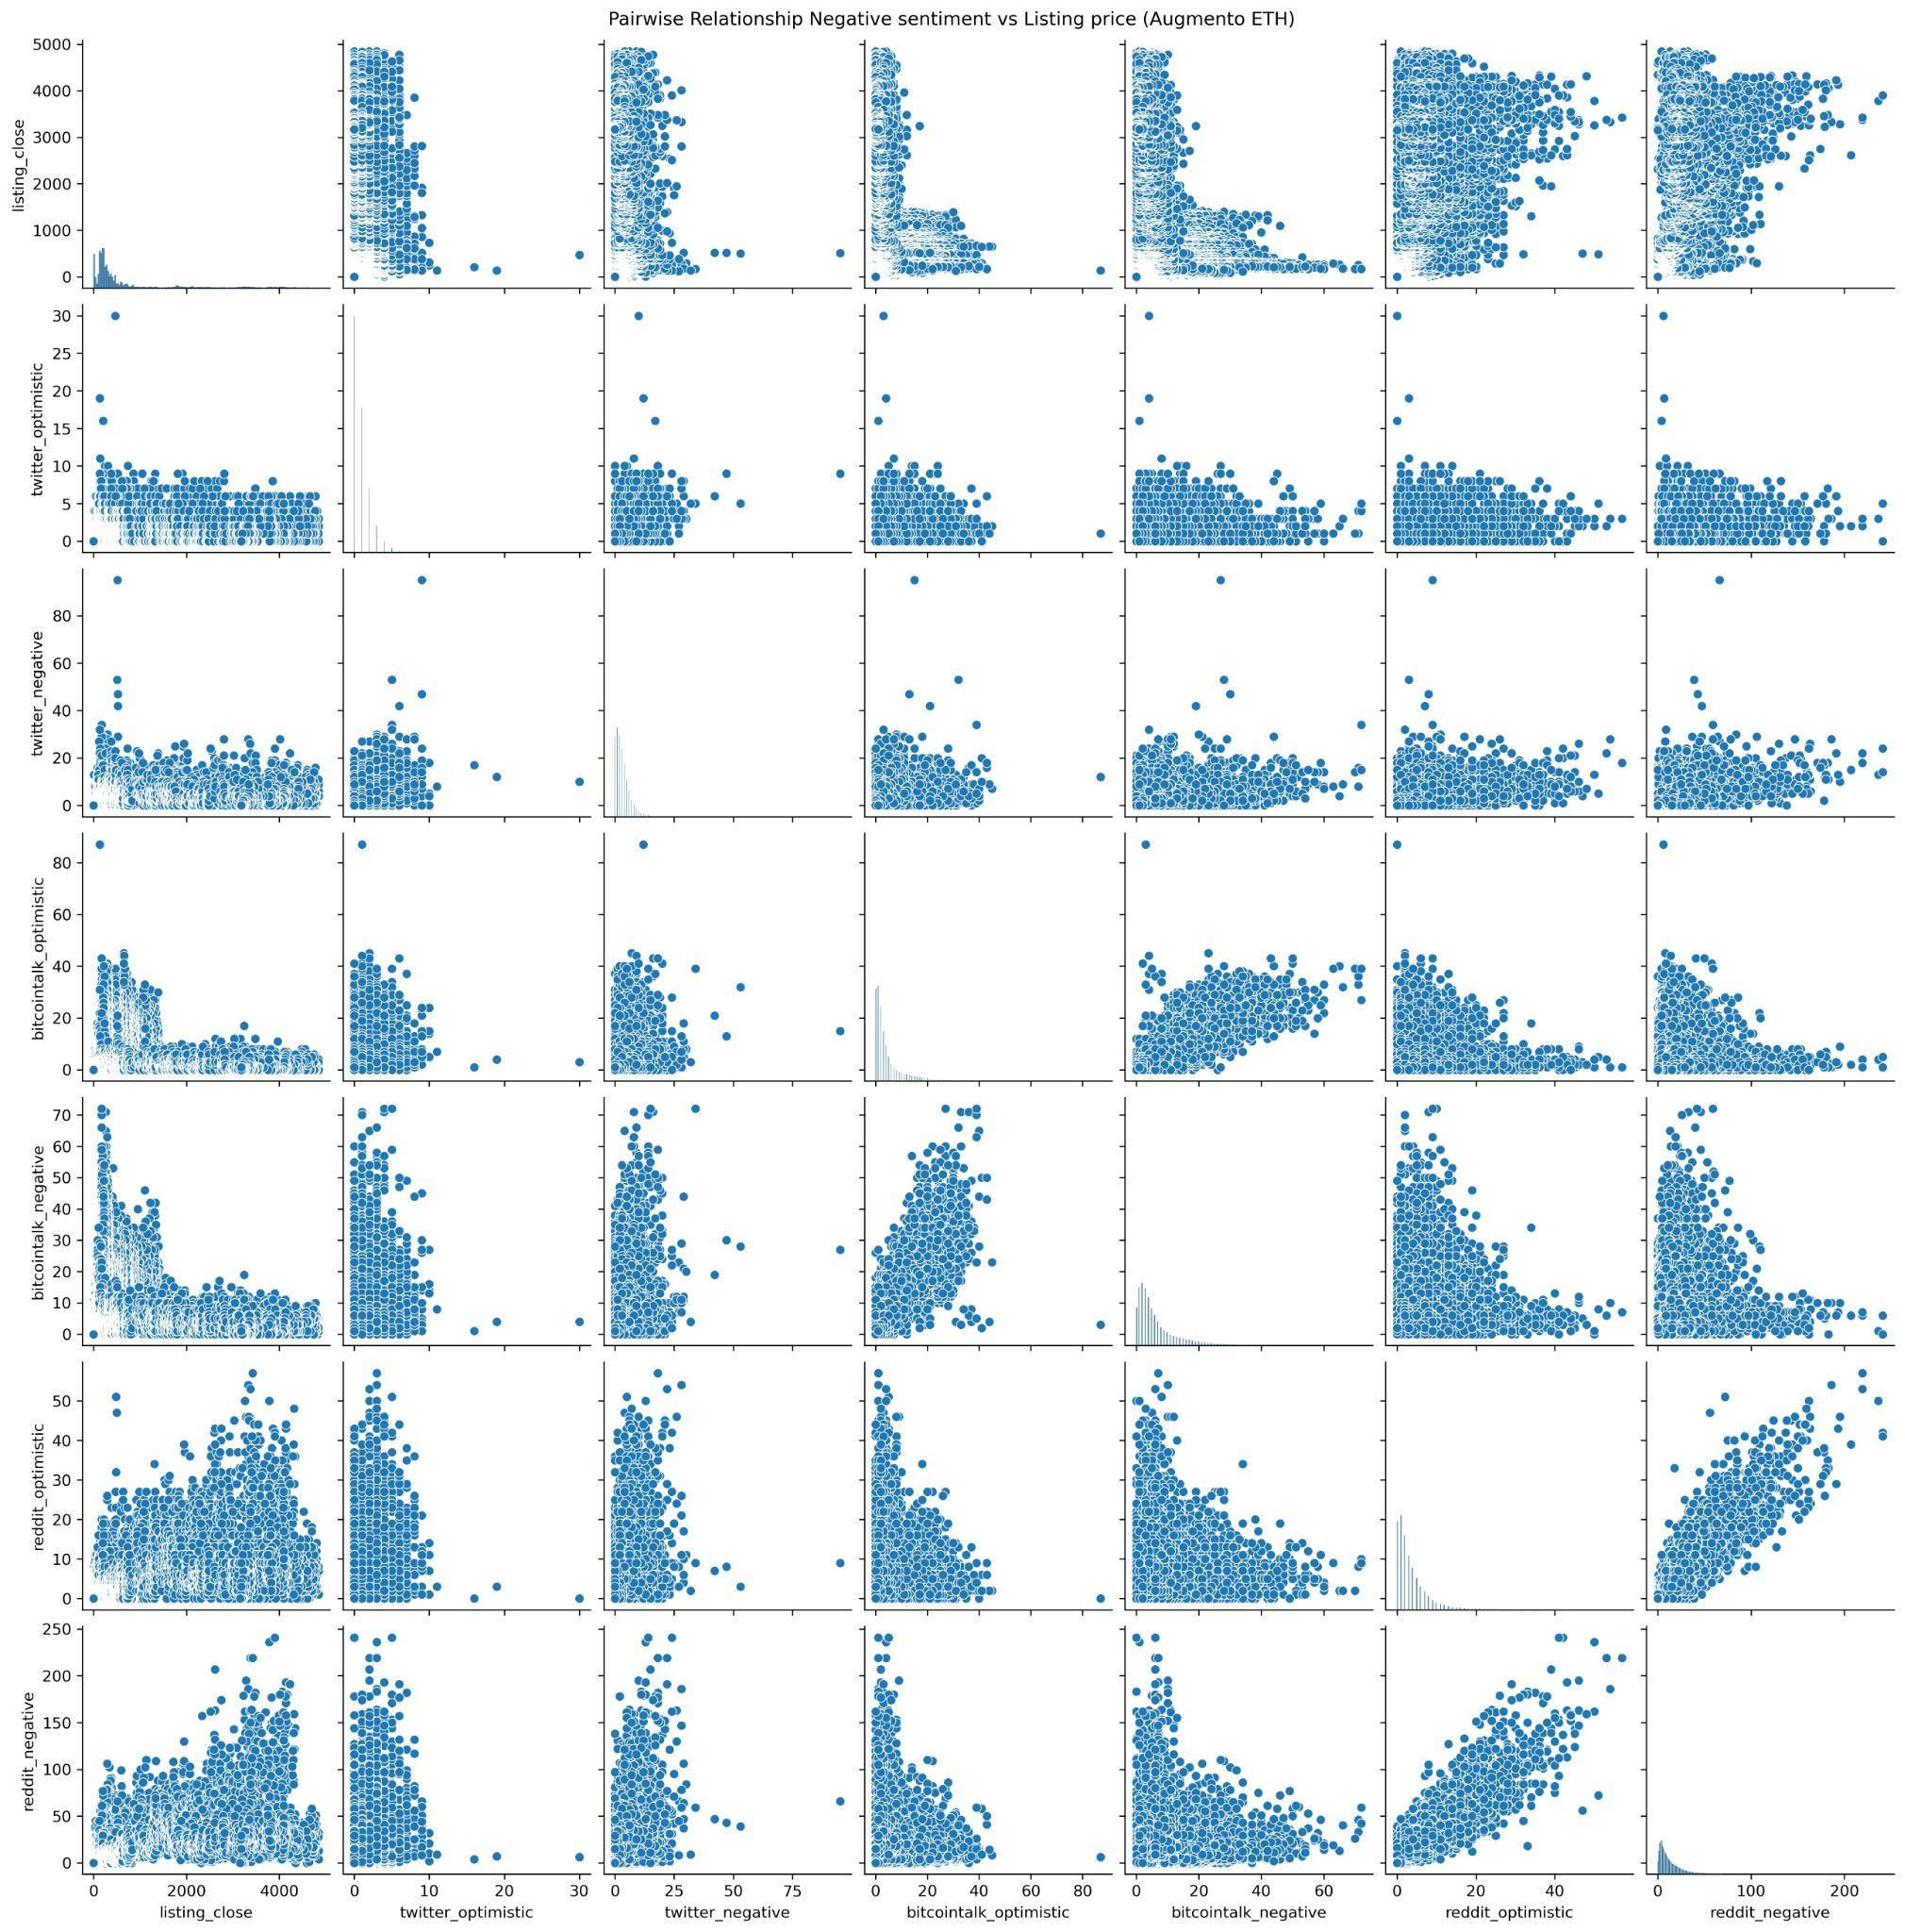
Correlation between Sentiment Values and Cryptocurrency Value (Augmento ETH)

Slide 8
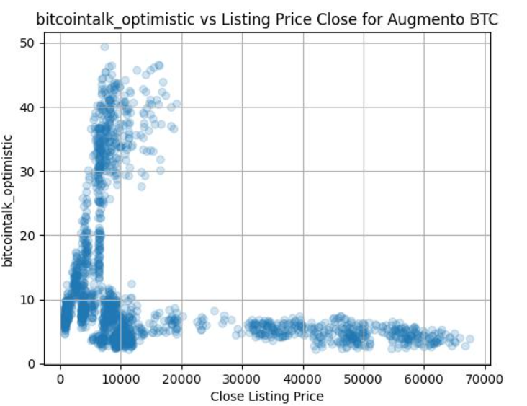
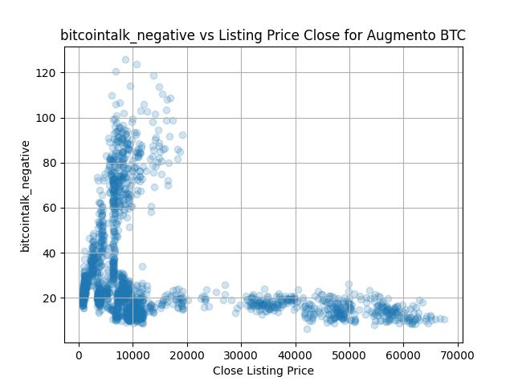
Comparison Bitcointalk Optimistic vs Negative

Slide 9
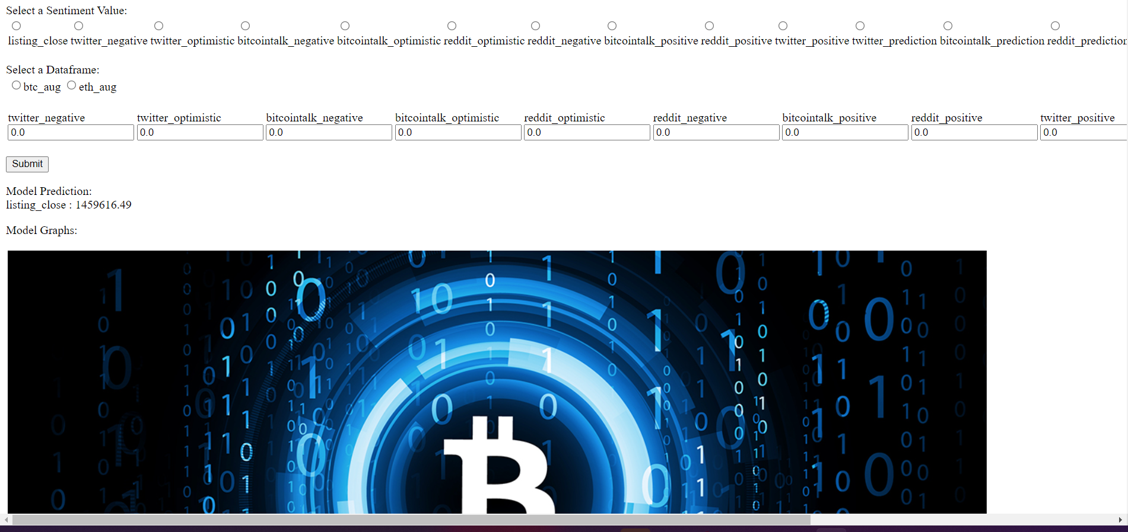
Flask Web App

Slide 10
Future Work
Make Web app prettier and adjusted to size of window
Testing the web app more, directly retrieve api from site
Add in different Regression
Ability for user to save the plot
Add in data analysis for Senticrypt into Flask webapp
Make plot ticks have better looking visualization

Slide 11
Conclusion
Linear Regression Model Precision: 61%
Relation between Sentiment and Cryptocurrency Value
Engineered Model that predicts Cryptocurrency Value
Created Web app for Users to interact with

Slide 12
Appendix
APIs:
Augmento:https://www.augmento.ai/
SentiCrypt:https://senticrypt.com/docs.html
Timeframe:
Augmento: November 2016 - January 2022
SentiCrypt: January 2022

Slide 13
Thank you

